Slide 1

STATUS UPDATE
DECISION DECK
Project Atlas
rollout status
Overall status: Amber. Two distribution centers are live and stable, Rivermark is ready,
but integration defects have consumed schedule buffer. Oakport must move by three
weeks. Benefits remain achievable if two decisions are made this week.
Reporting date: 30 June 2027 · Audience: COO, CFO, operations director, program sponsor and site leads · Source: user brief.
DECISION DECK
Notes:
The overall status is Amber. Delivery remains recoverable, but the plan now depends on funding the integration response and approving the revised site sequence this week.

Slide 2
02 EXECUTIVE STATUS
DECISION DECK
Amber overall: integration drives the exception
Overall
AMBER
Completion
2 of 6 live
Forecast
15 Nov
EAC
€8.67m
Buffer
6 days
WORKSTREAM
RAG
CURRENT FACT
NEXT MILESTONE
Site rollout
AMBER
2 of 6 live; Rivermark ready
Rivermark go-live 12 Jul
Core platform
GREEN
99.93% uptime over 30 days
Release 3.4 on 8 Jul
ERP integration
RED
17 priority defects; 6 block Oakport
Burn-down to 4 by 16 Jul
Data migration
AMBER
98.6% record pass rate
Oakport rehearsal 19 Jul
Training
GREEN
684 of 720 users certified
Oakport completion 23 Jul
Benefits
AMBER
€0.62m annualized vs €0.71m plan
Validate Rivermark after 30 days
02 / 10
Notes:
ERP integration is the only Red workstream and is driving the overall Amber rating. Platform stability and training performance provide a sound base for recovery.

Slide 3
03 MILESTONE MOVEMENT
DECISION DECK
Oakport moves three weeks; completion moves seven days
10 MAR
28 APR
12 JUL
30 AUG
4 OCT
15 NOV
North Quay
Vale Cross
Rivermark
Oakport
Cedar Run
South Gate
10 Mar → 10 Mar
LIVE
21 Apr → 28 Apr
LIVE
12 Jul → 12 Jul
READY
9 Aug → 30 Aug
+21 DAYS
20 Sep → 4 Oct
+14 DAYS
8 Nov → 15 Nov
+7 DAYS
CRITICAL PATH
Baseline completion was 8 November. The current forecast is 15 November, while critical-path buffer has fallen from 28 days in April to
6 days now.
Movement calculated from the original and current go-live dates supplied in the user brief.
03 / 10
Notes:
The main movement is Oakport, which shifts from 9 to 30 August. The downstream sequence absorbs part of that delay, leaving final completion seven days later than baseline.

Slide 4
04 SITE ROLLOUT
DECISION DECK
Two sites are stable; Rivermark is ready
SIX-SITE ROLLOUT SEQUENCE
SITE
ORIGINAL GO-LIVE
CURRENT GO-LIVE
MOVEMENT
STATUS
FIRST 14-DAY ACCURACY
North Quay
10 Mar
10 Mar
0 days
LIVE
99.2%
Vale Cross
21 Apr
28 Apr
+7 days
LIVE
98.8%
Rivermark
12 Jul
12 Jul
0 days
READY
Not live
Oakport
9 Aug
30 Aug
+21 days
AT RISK
Not live
Cedar Run
20 Sep
4 Oct
+14 days
WATCH
Not live
South Gate
8 Nov
15 Nov
+7 days
WATCH
Not live
NEXT GATE
Conduct the Rivermark go/no-go on 10 July for go-live on 12 July.
04 / 10
Notes:
The two live sites have both delivered first-14-day accuracy above 98.8 percent. Rivermark remains on its original date and is the next proof point before Oakport.

Slide 5
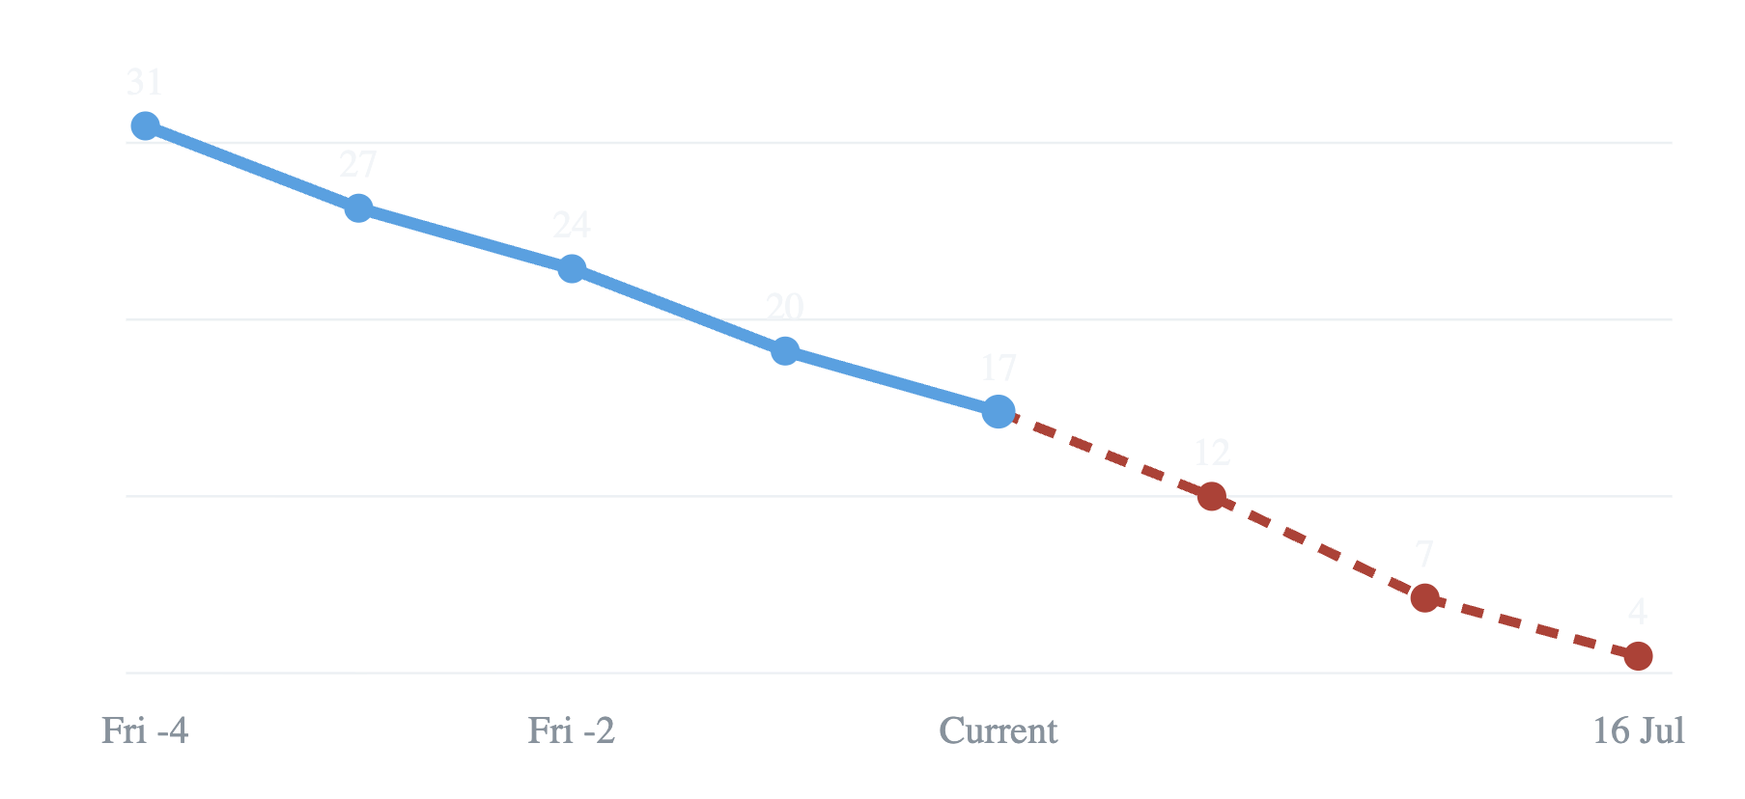
05 INTEGRATION RECOVERY
DECISION DECK
Defect closure is improving, but six still block Oakport
PRIORITY DEFECTS OPEN
142
9
of 168 interfaces
accepted
interfaces currently in test
17
6
priority defects remain
defects block Oakport
Actual
Recovery target
RECOVERY METHOD
Daily defect room, freeze noncritical changes and
add two vendor engineers for six weeks.
Source: user brief. Recovery dates correspond to the next three Fridays, ending 16 July.
05 / 10
Notes:
Open priority defects have fallen from 31 to 17 over five Fridays. Recovery requires the rate to accelerate so the backlog reaches four by 16 July, including closure of all six Oakport blockers.

Slide 6
06 BUDGET AND SCHEDULE
DECISION DECK
Recovery lifts EAC by €0.27m, or 3.2%
€5.76m
68.6%
actual plus committed through
June
of approved budget committed
or spent, derived
+7 days
6 days
completion movement from 8 to
15 Nov
critical-path buffer, down from
28
€8.40m
+€0.19m
+€0.11m
−€0.03m
€8.67m
Approved
Integration
Site support
Travel
EAC
DERIVED CALCULATION
€5.76m ÷ €8.40m = 68.6%. EAC variance is €8.67m − €8.40m
= €0.27m.
Source: user brief. Bridge components reconcile from approved budget to estimate at completion.
06 / 10
Notes:
The forecast overrun is concentrated in integration recovery and extended site support. Lower travel offsets only a small part of the increase, leaving EAC 3.2 percent over the approved budget.

Slide 7
07 BENEFITS AND OPERATIONS
DECISION DECK
Live sites show the operating case is working
6.6 min
1.9%
−11%
99.0%
average pick time, down from
7.8 minutes
inventory adjustments, down
from 3.1% of lines
overtime hours at the two live
sites
combined order accuracy vs
98.4% baseline
€0.62m
Labor productivity €0.31m
Errors and credits €0.21m
Overtime
€0.10m
Labor
productivity
€0.31m
Fewer
errors
and
credits
€0.21m
Lower
overtime
€0.10m
annualized gross benefit live, versus
€0.71m plan
Source: user brief. Benefit shares are derived from €0.31m, €0.21m and €0.10m, totaling €0.62m.
07 / 10
Notes:
Operational results at North Quay and Vale Cross support the benefits case. Annualized benefit is currently €0.09m below plan, but the full program benefit remains achievable if the rollout sequence is protected.

Slide 8
08 RISKS AND ISSUES
DECISION DECK
Integration is the quantified threat; ownership gaps remain
RISK OR ISSUE | PROBABILITY / IMPACT | QUANTIFICATION | RESPONSE | OWNER
ERP integration defects | High / High | €0.34m exposure; 17 priority defects | Daily defect room; change freeze; two vendor engineers | Ivo Marin
Oakport peak-season collision | Medium / High | No go-live after 5 Sep; 6-day stabilization window | Move Oakport to 30 Aug | Not specified in brief
Data-quality exceptions | Medium / Medium | 18,420 of 1.31m failed first pass; 13,270 corrected | Correct remaining exceptions; rehearse 19 Jul | Not specified in brief
Supervisor coverage | Medium / Medium | 14 of 18 Oakport floor champions certified | Certify four remaining champions by 23 Jul | Not specified in brief
GOVERNANCE GAP
The supplied evidence names only the integration-risk owner. The sponsor should confirm accountable owners for the other three risks when the revised
integrated plan is published.
Source: user brief. Missing owners are shown explicitly rather than inferred.
08 / 10
Notes:
The integration risk has both a named owner and quantified exposure. The brief does not supply owners for the other three risks, so the governance gap is made explicit for resolution rather than hidden by assumptions.

Slide 9
09 RECOVERY PLAN
DECISION DECK
Two decisions are required this week
01
DECISION 1
02
DECISION 2
By 3 July
By 5 July
Authorize €0.22m contingency for the
integration recovery team.
Approve Oakport's move from 9 August to 30
August and the downstream dates already in the
deck.
CONSEQUENCE
Both decisions preserve the 15 November completion forecast and keep the €0.62m live annualized
benefit case achievable.
09 / 10
Notes:
Two decisions are required this week. Authorize the €0.22m contingency by 3 July, then approve Oakport's move and the downstream dates by 5 July to preserve the 15 November forecast and keep the €0.62m benefit case achievable.

Slide 10
10 RECOVERY PLAN
DECISION DECK
Five dated actions protect the revised sequence
7 JUL
16 JUL
19 JUL
23 JUL
Publish
revised plan
10 JUL
Close
blockers
Rehearse
Oakport
Complete
coverage
Gate
Rivermark
Reflect approved
site dates and
recovery
resources.
Close six
Oakport
blockers; reduce
priority defects to
four.
Validate migrated
data and
operational
readiness.
Certify four
remaining
Oakport floor
champions.
Conduct go/no-
go for the 12 Jul
launch.
PEOPLE
CONTROL
CADENCE
Add two engineers
Freeze noncritical change
Run a daily defect room
Vendor engineers join the integration response
for six weeks.
Protect defect capacity and platform stability.
Track closure, retest and escalation against the
16 July target.
Source: user brief. Action owners were not supplied and should be assigned in the revised integrated plan.
10 / 10
Notes:
The recovery plan is deliberately short and dated. Its critical gate is 16 July, when all six Oakport blockers must be closed and the remaining priority backlog reduced to four.

